Slide 1

A Basic Introduction to Machine Learning & Google Colab

Slide 2

What is Machine Learning?
A scientific field that uses algorithms to find patterns with given data.
Used in many fields
Medical Field to analyze patient data
Resume Screening
Spam Filtering
Product/Social Media Post Recommendation
Weather Forecasting
Stock Market Prediction
Generative Models like ChatGPT and Stable Diffusion

Slide 3
Types of Learning
Supervised Learning
Uses a collection of labeled input data to receive output data.
Regression Models
Predicting continuous values like house prices
Classification Models
Predicting whether an email is spam.
Unsupervised Learning
Does not use labeled input and output data.

Slide 4
How Does One Start?
Obtain Data
Preprocess and Loading Data
Splitting Data
Training Set
Used to train model
Test Set
Used for evaluating model. These are data the model has not seen.
Validation Set
Used to fine tune hyperparameters.
Creating Model
Train Model
Validate and Test model (If split from before)

Slide 5
Machine Learning Models/Architectures
Feed Forward Neural Networks
Recurrent Neural Networks
LSTMs
Concurrent Neural Networks
And more!

Slide 6
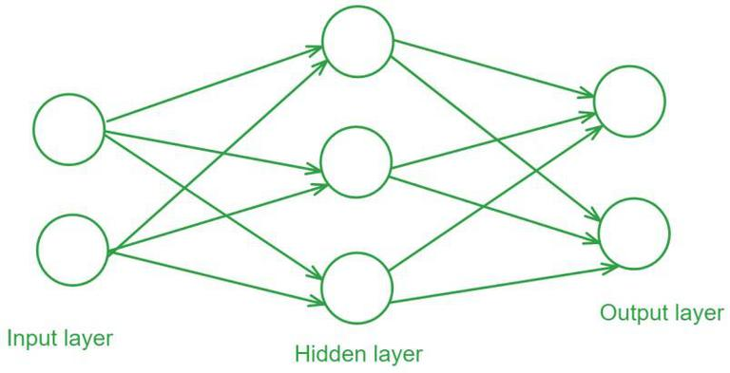
Feed Forward Neural Networks

Slide 7
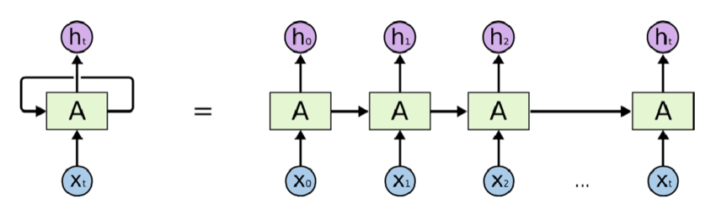
Recurrent Neural Networks

Slide 8
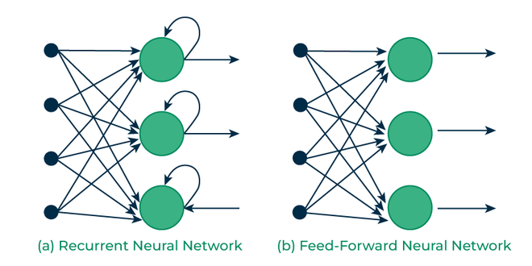

Slide 9
Google Colab
A web-based platform that runs on servers from Google.
Uses the hardware from Google’s servers so you don’t have to.
Great for learning

